Slide 1
Machine Learning Crash Course – Linear Regression

Slide 2
Slido and Crash Course Worksheet
If you feel uncomfortable asking questions in front of the class, you can ask them anonymously at any time on slido (link on next slide)
A weekly quiz will also be on slido
https://colab.research.google.com/drive/1Kj8Fpk9udSFBrudio0FY9jd_JZgVootd?usp=sharing – Machine Learning Crash Course workbook link – Will have questions for each week of content
Workbook questions will cover all 3 of machine learning theory, maths and coding (in python).

Slide 3


Join at slido.com #3867434
ⓘ Start presenting to display the joining instructions on this slide.

Slide 4
Quick Recap of Last Week…
Classification vs Regression Problems
Supervised Learning, Unsupervised Learning
Basic Supervised Learning Pipeline

Slide 5
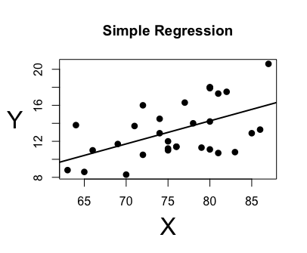
What is Linear Regression?
In Machine Learning, Linear Regression models the relationship between a dependent variable (output variable) Y and one or more independent variables (input variables) X using a linear equation.
Linear regression involves drawing a line of best fit through data points

Slide 6
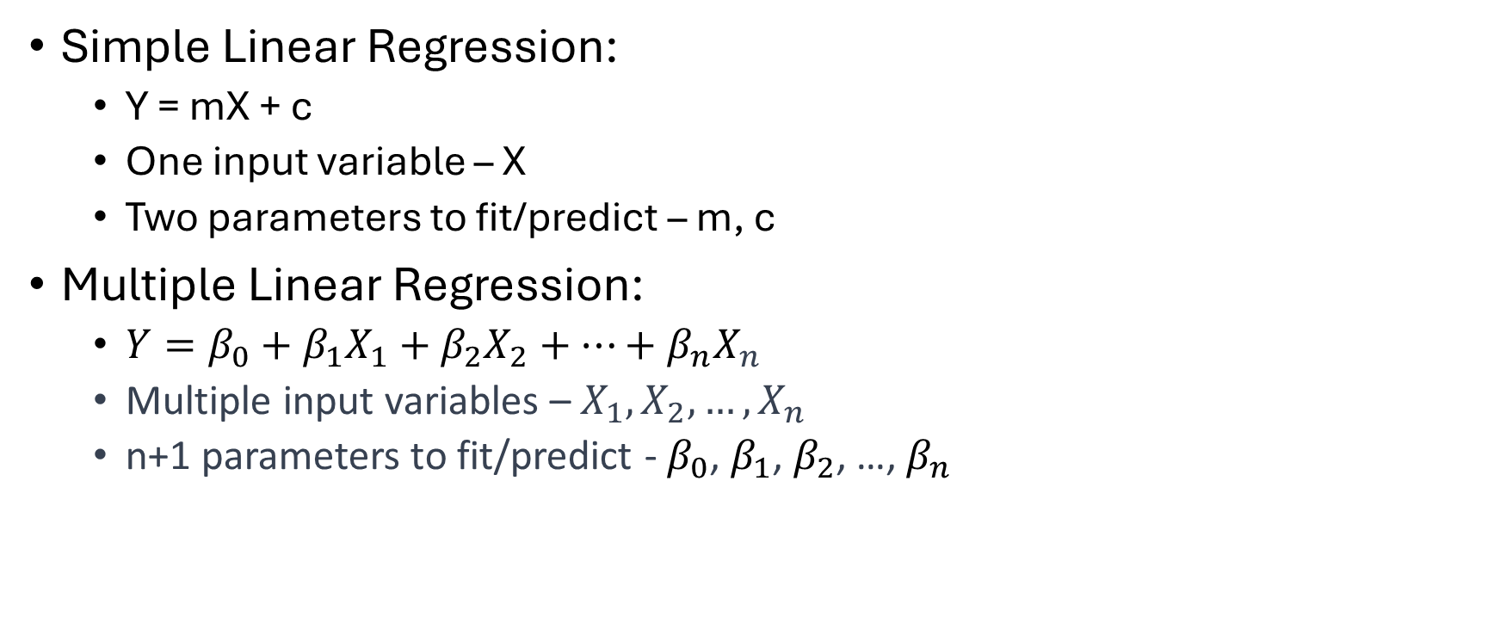
Simple Linear Regression vs Multiple Linear Regression
Simple Linear Regression:
Y = mX + c
One input variable – X
Two parameters to fit/predict – m, c
Multiple Linear Regression:
$Y=β_{0​}+β_{1}X_{1​}+β_{2}​X_{2​}+…+β_{n}​X_{n}​$
Multiple input variables – $X_{1},X_{2},…, X_{n}$
n+1 parameters to fit/predict - $β_{0​}$, $β_{1}$, $β_{2}$, …,${ β}_{n}$

Slide 7
Simple Linear Regression Walkthrough
Consider the case of predicting a student’s exam score in percent based on how many hours they studied.
Y = mX + c
What does Y represent in this example?
What does X represent in this example?
How can we get the best possible line of best fit through the data points?
Notes:
Mainly should be done on whiteboard through class discussion

Slide 8
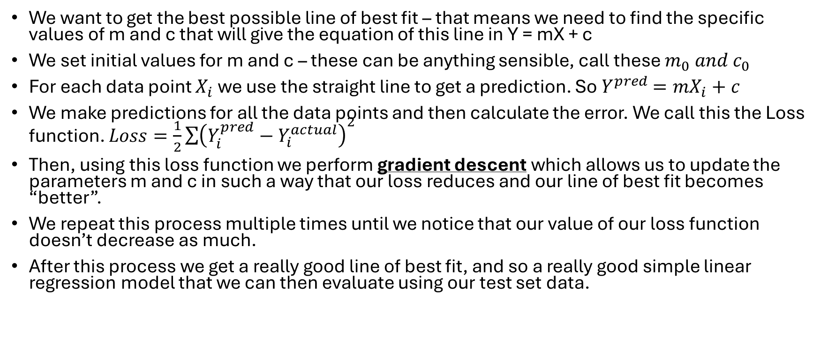
Getting the best possible line of best fit (Training our Simple Linear Regression model)
We want to get the best possible line of best fit – that means we need to find the specific values of m and c that will give the equation of this line in Y = mX + c
We set initial values for m and c – these can be anything sensible, call these $m_{0} and c_{0}$
For each data point $X_{i}$we use the straight line to get a prediction. So $Y^{pred}$ $=mX_{i}+c$
We make predictions for all the data points and then calculate the error. We call this the Loss function. $Loss=\frac{1}{2}\sum{{\left(Y_{i}^{pred}−Y_{i}^{actual}\right)}^{2}}$
Then, using this loss function we perform gradient descent which allows us to update the parameters m and c in such a way that our loss reduces and our line of best fit becomes “better”.
We repeat this process multiple times until we notice that our value of our loss function doesn’t decrease as much.
After this process we get a really good line of best fit, and so a really good simple linear regression model that we can then evaluate using our test set data.

Slide 9
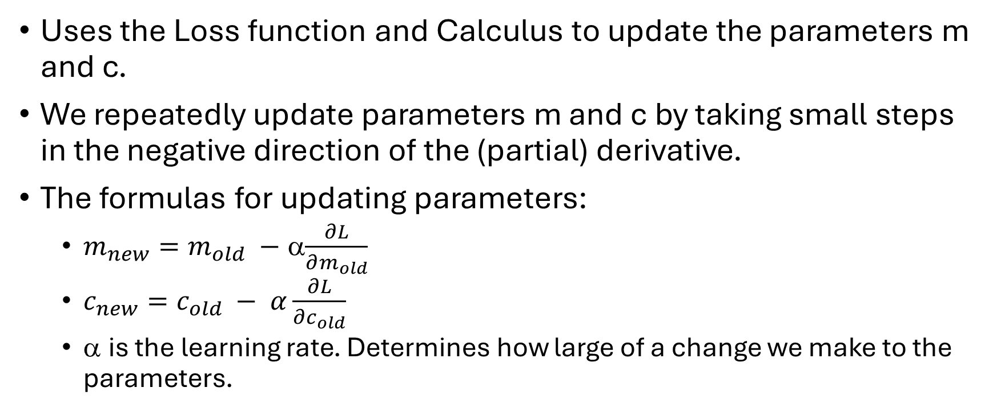
So what exactly is gradient descent?
Uses the Loss function and Calculus to update the parameters m and c.
We repeatedly update parameters m and c by taking small steps in the negative direction of the (partial) derivative.
The formulas for updating parameters:
$m_{new}=m_{old} −$ α$\frac{∂L}{∂m_{old}}$
$c_{new}=c_{old} − α\frac{∂L}{∂c_{old}}$
α is the learning rate. Determines how large of a change we make to the parameters.
Notes:
Should use mainly whiteboard and diagrams for this. Explain calculus and detailed breakdown on whiteboard.

Slide 10
Slido Quiz

